Slide 1
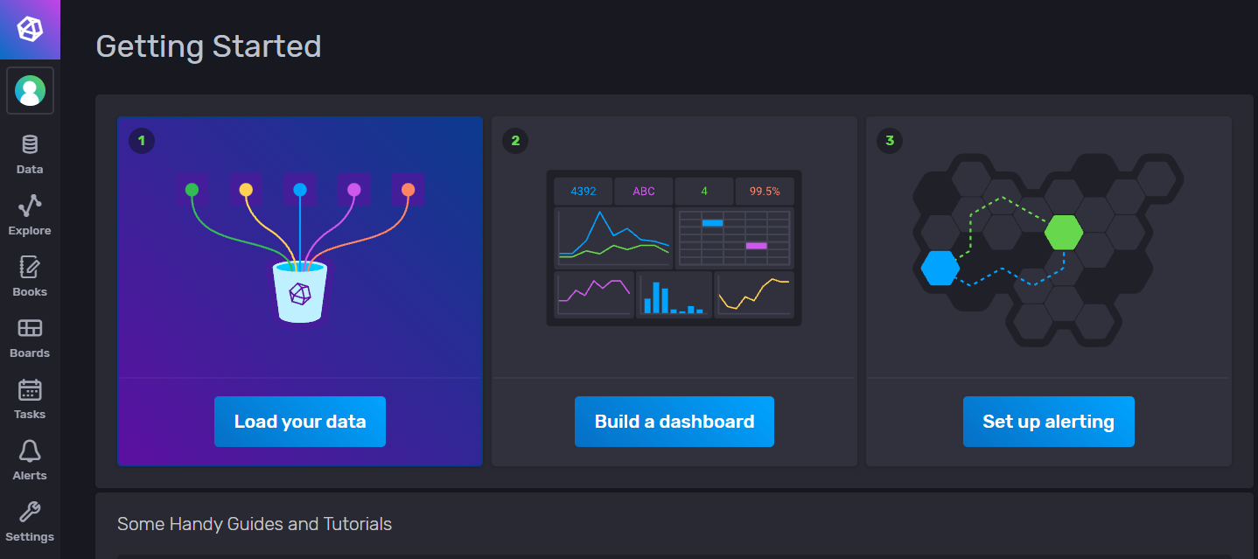
Influxdb is set up

Slide 2
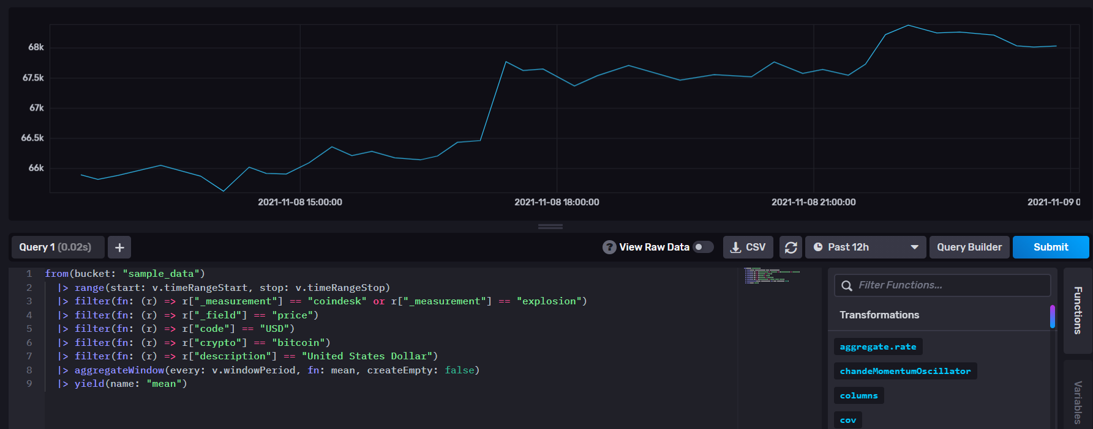
Tested out a sample dataset on bitcoin, just to see how influxdb works

Slide 3
Additional questions
The main challenge I am having and looking into currently is loading the data queries from the Sage API so that I can graph the different values that we had discussed previously such as sys.cooling and power consumption.
Could I get some advice or pointers on how to upload the dataset that we are using?
Slightly unrelated to project but important, nonetheless. Who can I contact in regard to finding what my password is for my Argonne email address and logging into Outlook (Just in case I have gotten any emails and such)?
Two large projects were assigned back-to-back in the last two weeks that I had to complete, so I do apologize if there is not much shown here.

